Slide 1
Understanding Epidemiology of the Heart Disease
-- Data mining on Framingham Heart study dataset
Presented by
Notes:
-Data mining is the process of finding anomalies, patterns and correlations within large data sets to predict outcomes
-The Framingham Heart Study is a long-term, ongoing cardiovascular cohort study of residents of the city of Framingham, Massachusetts. The study began in 1948 with 5,209 adult subjects from Framingham, and is now on its third generation of participants

Slide 2
Epidemiology
It is the study of diseases in populations, specifically how, when and where they occur.
It is an attempt to understand what are the risk factors associated with a disease and which factors may protect the individual from the disease.
Here we attempt to understand these distributions by closely looking at the Framingham heart study data set and see:-
1. How the data is distributed,
2. The relationship between different heart diseases and their respective risk factors)
i) BMI, sysBP, diaBP, prevalentHy, prevalentStroke, smoking, age, gender, education
The dataset used in this project - Framingham Heart Study dataset was provided on request by NHLBI
Notes:
Epidemiology: Epidemiology is the study of how often diseases occur in different groups of people and why?
Includes: the study and analysis of the distribution (who, when, and where) and determinants of health and disease conditions in defined populations

Slide 3
New Inferences and Assumptions
We created two new variables :-
Pulse Pressure
BMI Class
Questions to address:-
Which BMI classes are the highest and lowest risks?
-Which variables are the best predictors for the risk of heart disease?
(Most important for me)

Slide 4
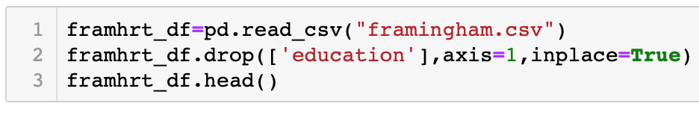
Methods: Data Preparation

Slide 5
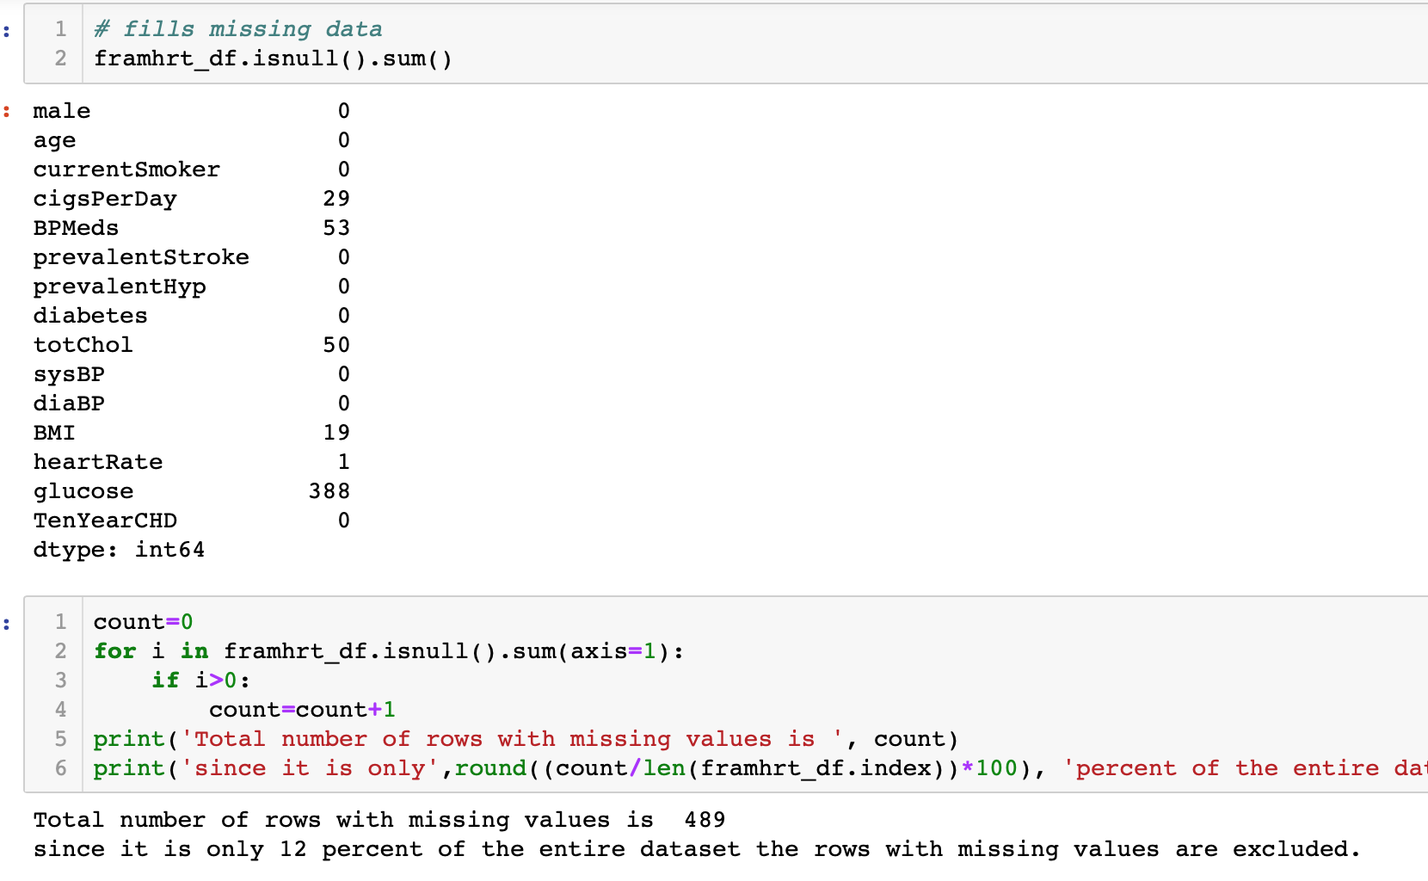
Data Preparation: Removing missing values

Slide 6
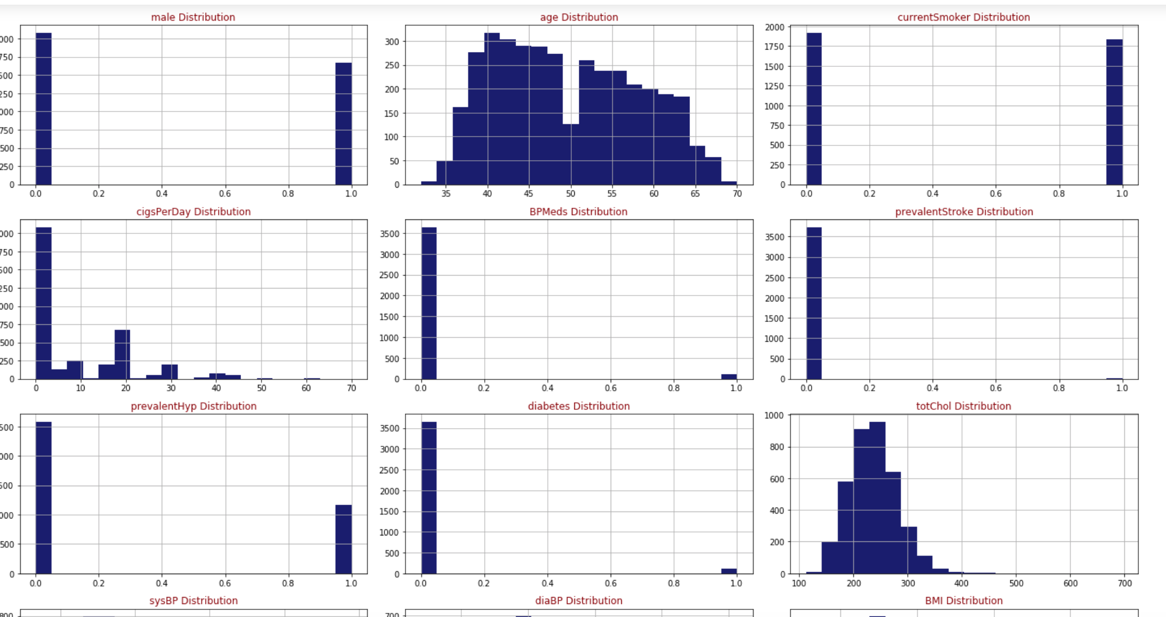
Data Exploration and Analysis: Relationships between variables

Slide 7
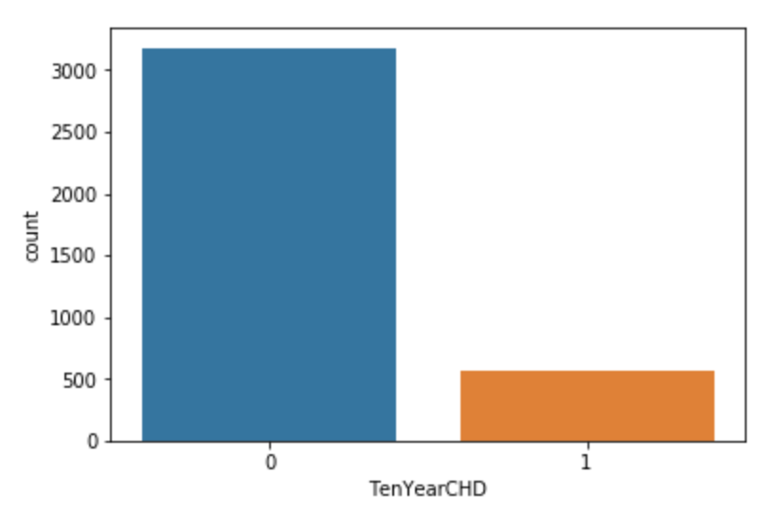
There are 3179 patents with no heart disease and 572 patients with risk of heart disease
Notes:
Based on the Framingham Risk Score: The 10-year cardiovascular risk of an individual can be estimated with the Framingham Risk Score, including for individuals without known cardiovascular disease. The Framingham Risk Score is based on findings of the Framingham Heart Study.

Slide 8
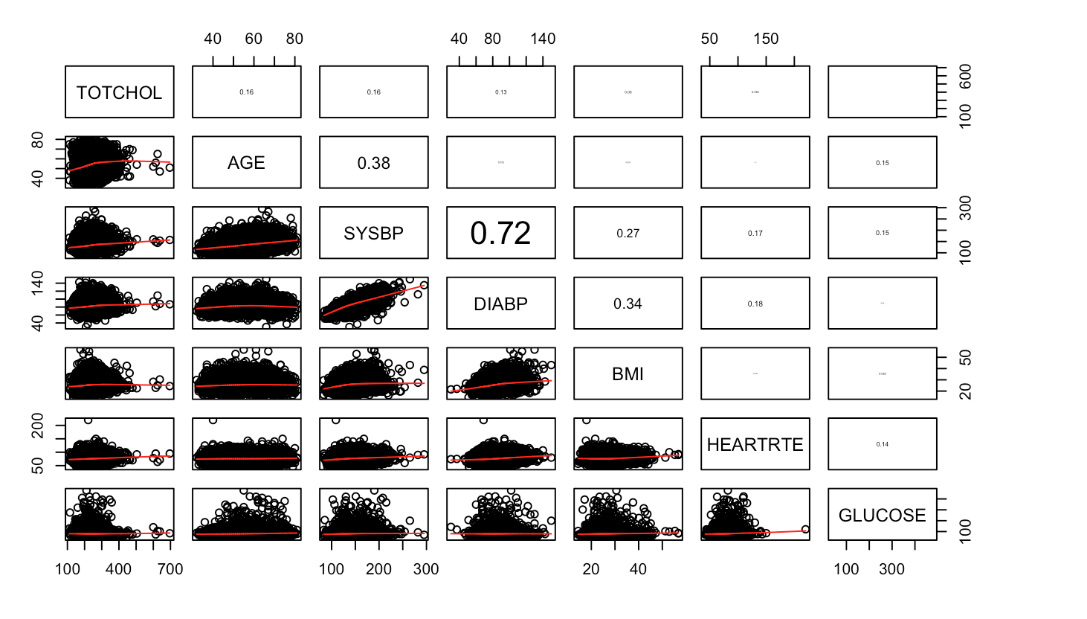
Plots explaining correlation between variables
Notes:
Total Cholesterol- HDL (the good cholesterol) + (the bad cholesterol) LDL

Slide 9
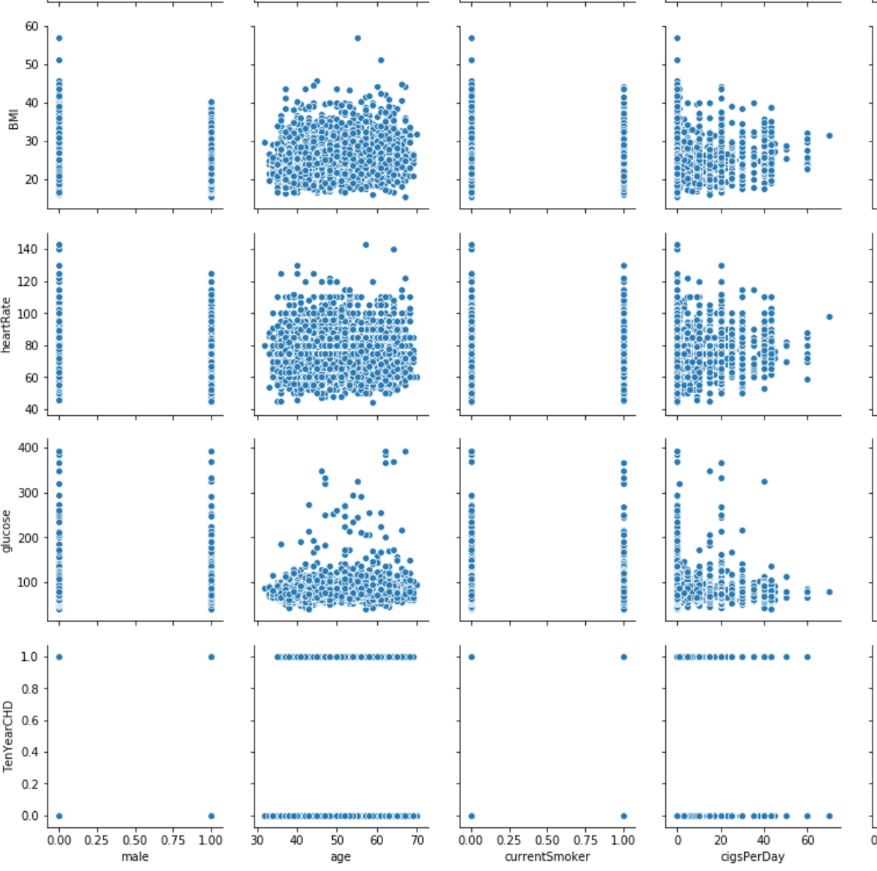
More correlation plots

Slide 10
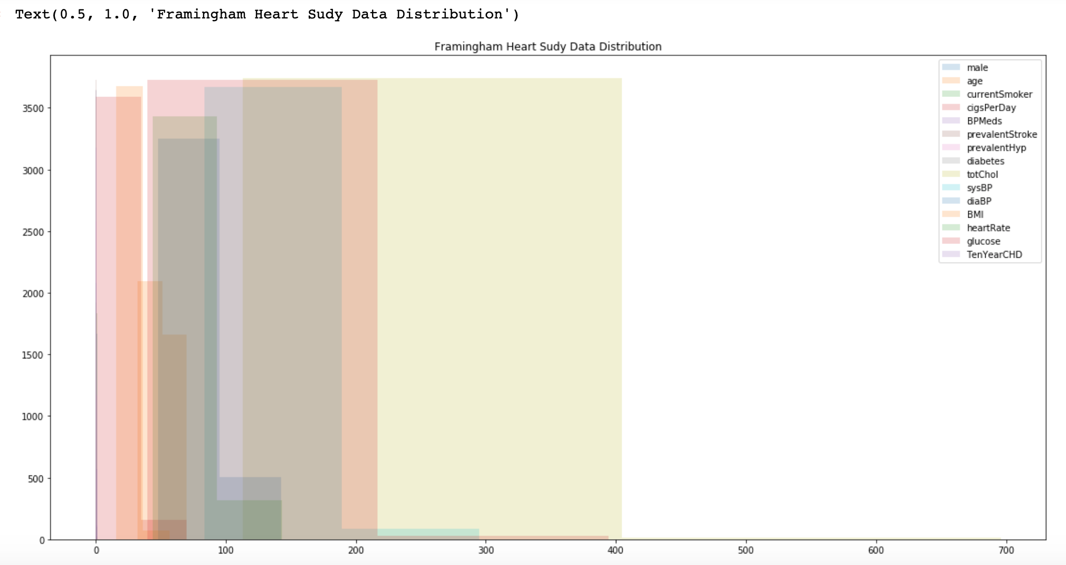
Distribution of data in the dataset

Slide 11
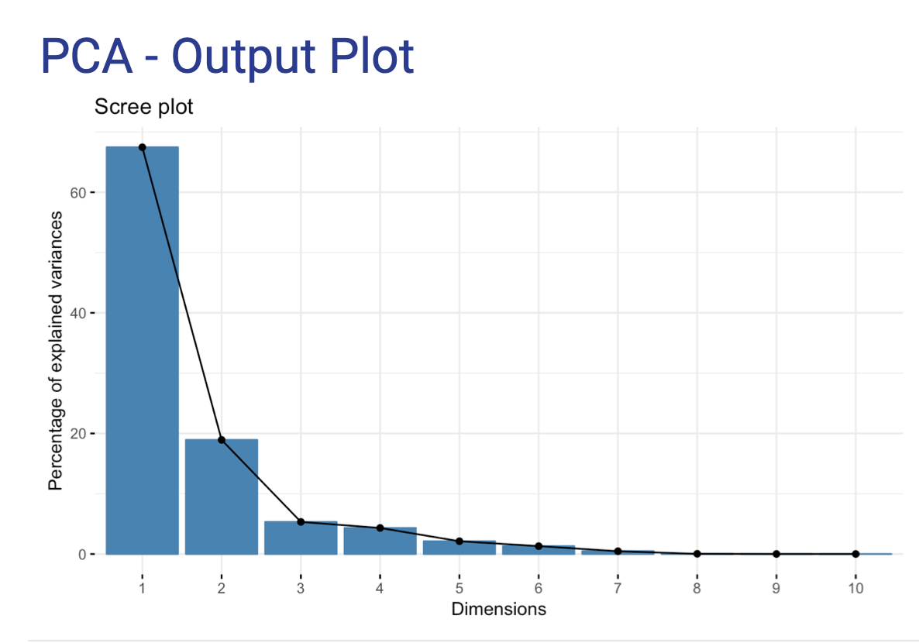
PCA: Dimensionality reduction and further explore relationships between variables
Notes:
Principal Component Analysis(PCA) is a dimension-reduction tool that can be used to reduce a large data set of variables to a small set that contains most of the information in the large dataset
(without taking out missing values)

Slide 12
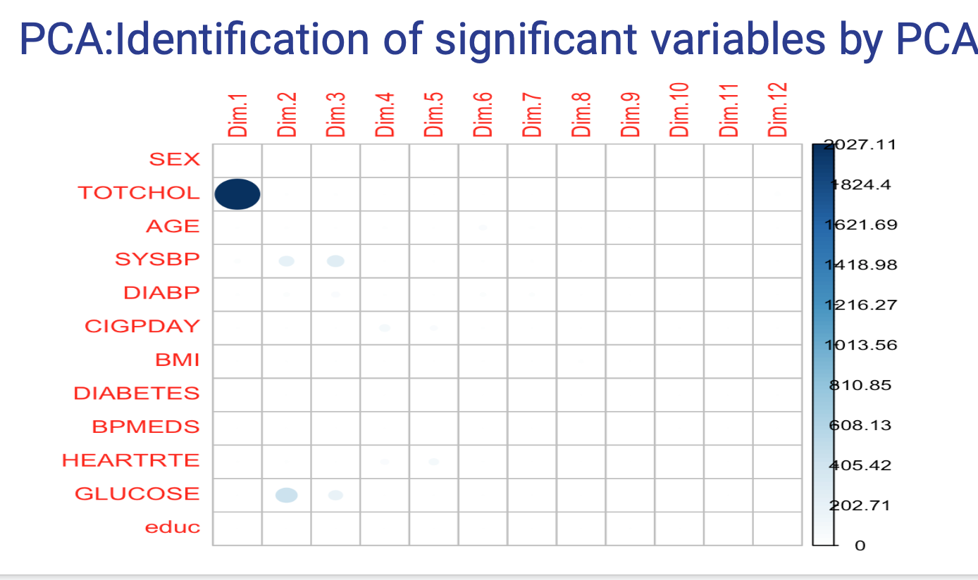
Important variables in PCAS
Notes:
Important Variables identified by PCA: hypertensive or arteriosclerotic cardiovascular disease, SYSBP, Glucose and surprisingly TOTAL CHOL.

Slide 13
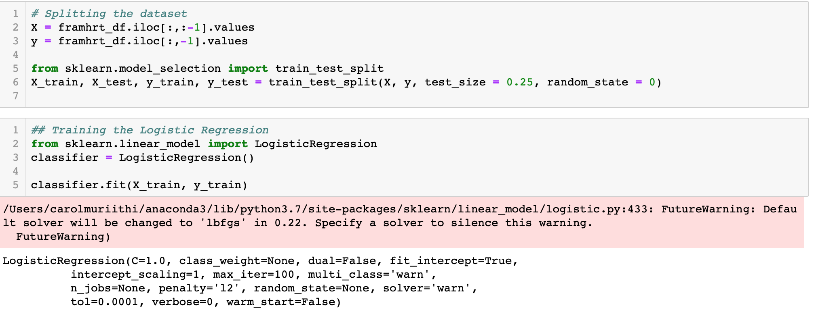
Logistic Regression Model to predict risk of CHD
Looking at the subset of the data that had the 10 years risk factor, we define a logistic model to predict the risk of developing heart disease within the next decade
i) Split my data into training and testing

Slide 14
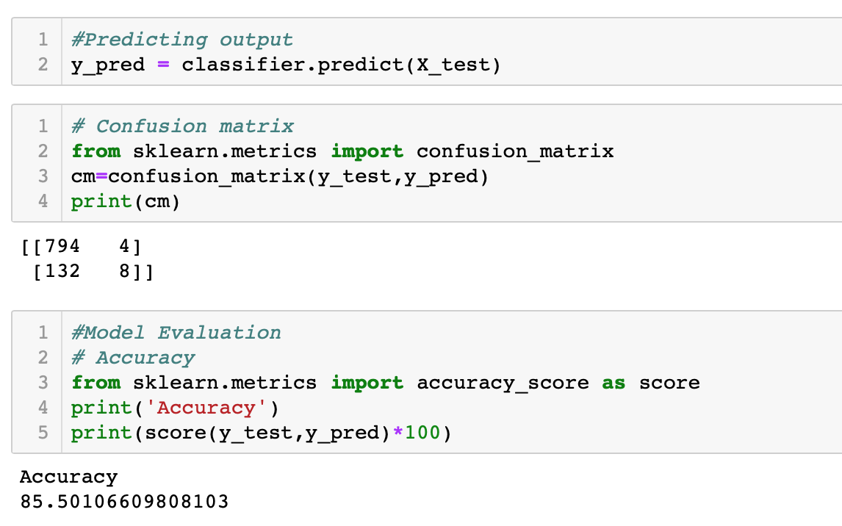
Logistic Regression
i) training data on subset of the data

Slide 15
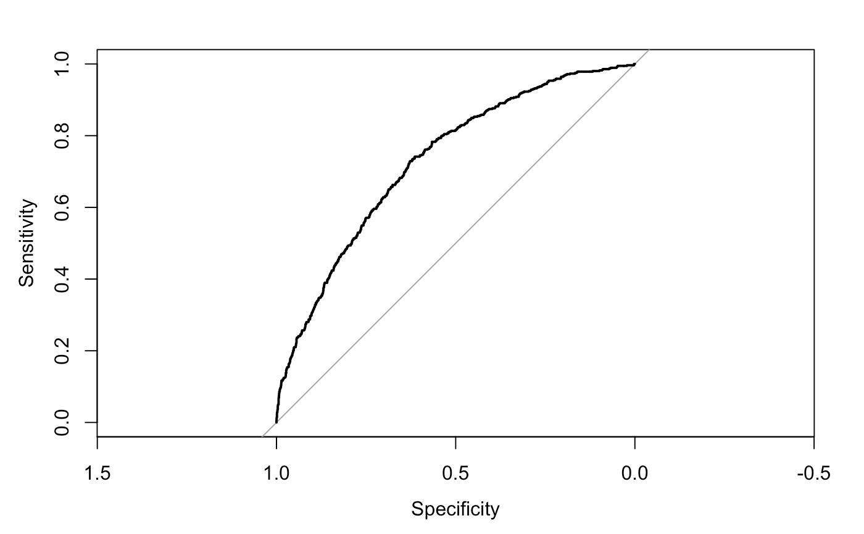
SUMMARY OF THE LOGISTIC MODEL AND ITS FITNESS
Deviance Residuals: Min 1Q Median 3Q Max -1.7868 -0.6002 -0.4329 -0.3032 2.7657 Coefficients: Estimate Std. Error z value Pr(>|z|) (Intercept) -8.449078 0.619429 -13.640 < 2e-16 *** sysBP 0.015557 0.003448 4.512 6.44e-06 *** diaBP 0.001631 0.006341 0.257 0.797 BMI 0.010380 0.012372 0.839 0.402 heartRate -0.005740 0.004166 -1.378 0.168 glucose 0.007567 0.001675 4.517 6.27e-06 *** age 0.066640 0.006650 10.021 < 2e-16 *** cigsPerDay 0.027630 0.003949 6.997 2.61e-12 *** education -0.046237 0.049568 -0.933 0.351 totChol 0.001612 0.001115 1.445 0.148 --- Signif. codes: 0 ‘***’ 0.001 ‘**’ 0.01 ‘*’ 0.05 ‘.’ 0.1 ‘ ’ 1 (Dispersion parameter for binomial family taken to be 1) Null deviance: 3121.2 on 3657 degrees of freedom Residual deviance: 2786.9 on 3648 degrees of freedom AIC: 2806.9
Notes:
Significant variables determined from the logistic model are - sysBP, age, cigsPerDay and glucose.

Slide 16
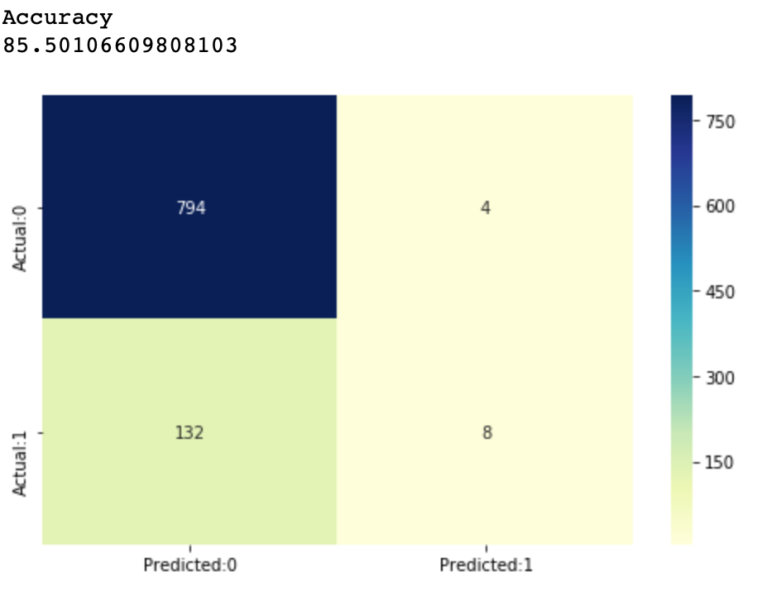
Model Accuracy: 85%

Slide 17
Conclusions
We were able to confirm the significant risk factors for heart disease using our logistic model (in agreement with Mahmood et al. 2013) -
Systolic Blood Pressure
Glucose levels
Average number of cigarettes smoked per day
Age
Total Cholesterol
Other risk factors that might help us better understand are:
Family History
Waist-Hip Ratio
Physical Activity
Ref- Mahmood, S. S., Levy, D., Vasan, R. S., & Wang, T. J. (2013). The Framingham Heart Study and the epidemiology of cardiovascular disease: a historical perspective. Lancet (London, England), 383(9921), 999-1008.

Slide 18
What was the most difficult part and what can I do to improve it
The sensitivity of the model was so low
How to improve it? Lower the Threshold
Missing values in the dataset: did that change anything?
Notes:
Sensitivity: ability of a test to correctly identify those with the disease( true positive)
Specificity: ability of the test to correctly identify those without the disease (true negative rate)

